Slide 1

Performance Considerations of an SAP Gateway Service
Katan Patel
SAP INSIDE TRACK BRISBANE FEBUARY 2018

Slide 2
Topics
Identifying Performance Problems
Development Considerations
Testing Options

Slide 3

Identifying Performance Problems

Slide 4
Identifying Performance Problems
GUI based options for gateway developers/administrators
Enabling an SAT trace for an ODATA Service Request
Browser Based options for web application developers

Slide 5
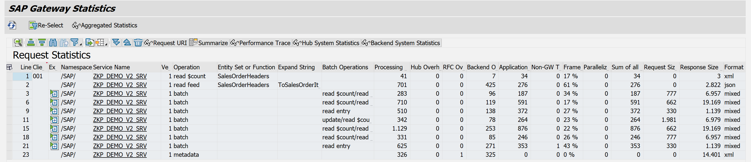
SAP Gateway Statistics (/IWFND/STATS)
Handy processing time stats for the SAP Gateway
Provides aggregated stats for daily system performance monitoring
Updates based on batch job for report /IWFND/R_METERING_AGGREGATE

Slide 6
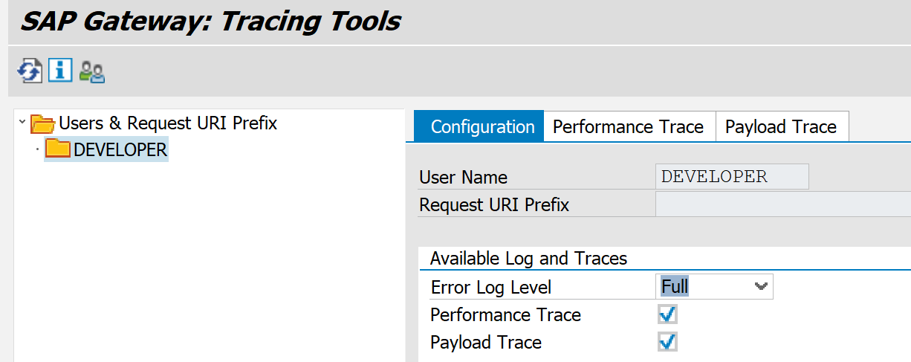
Performance Traces (/IWFND/TRACES)
Allows you to monitor the system at service call level
Activate the trace for a user and set the appropriate trace levels under the configuration tab

Slide 7
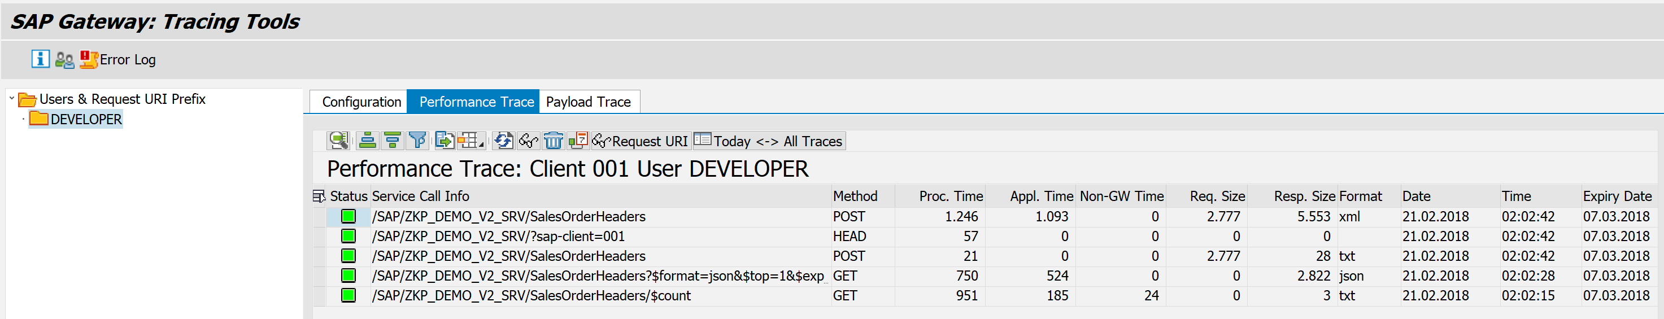
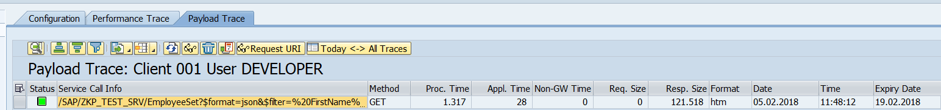
Performance Traces (/IWFND/TRACES)
Can view very detailed information about successful service calls

Slide 8
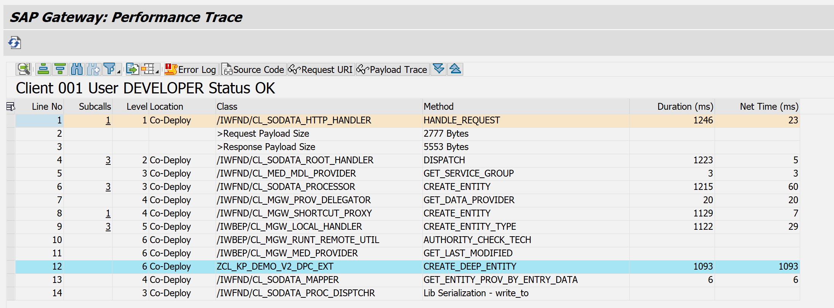
Performance Traces (/IWFND/TRACES)
Trace Details of the call stack
Only specifically for gateway methods

Slide 9
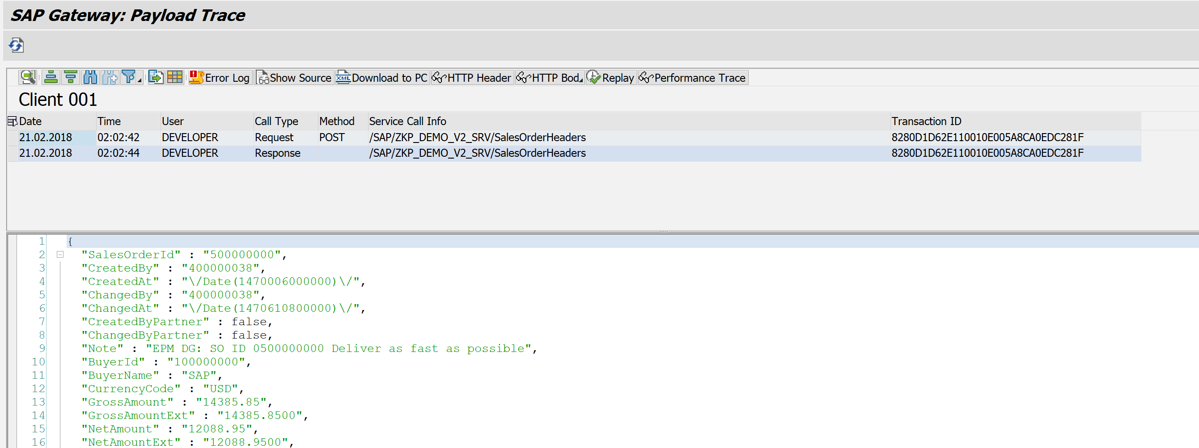
Performance Traces (/IWFND/TRACES)
Request/Response details
Navigate to error log for failed messages

Slide 10
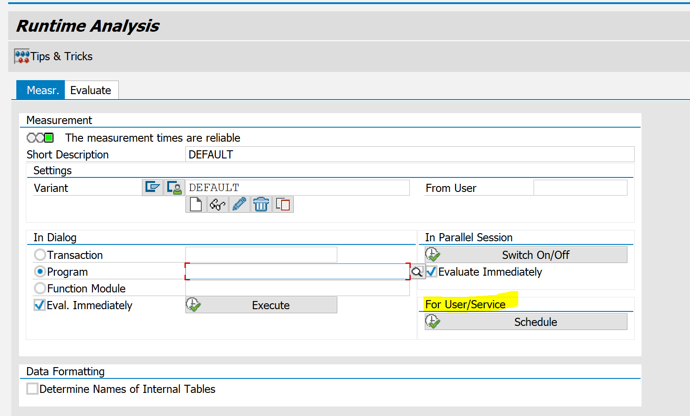
SAT Traces (SAT)
Detailed tracing for a full breakdown of the request handling
Schedule a new measurement for a user/service

Slide 11
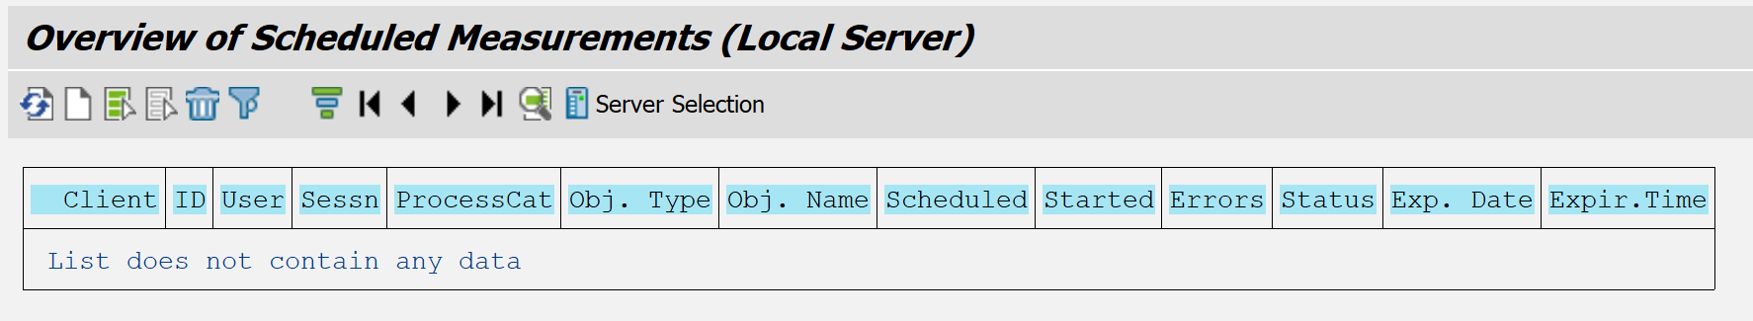
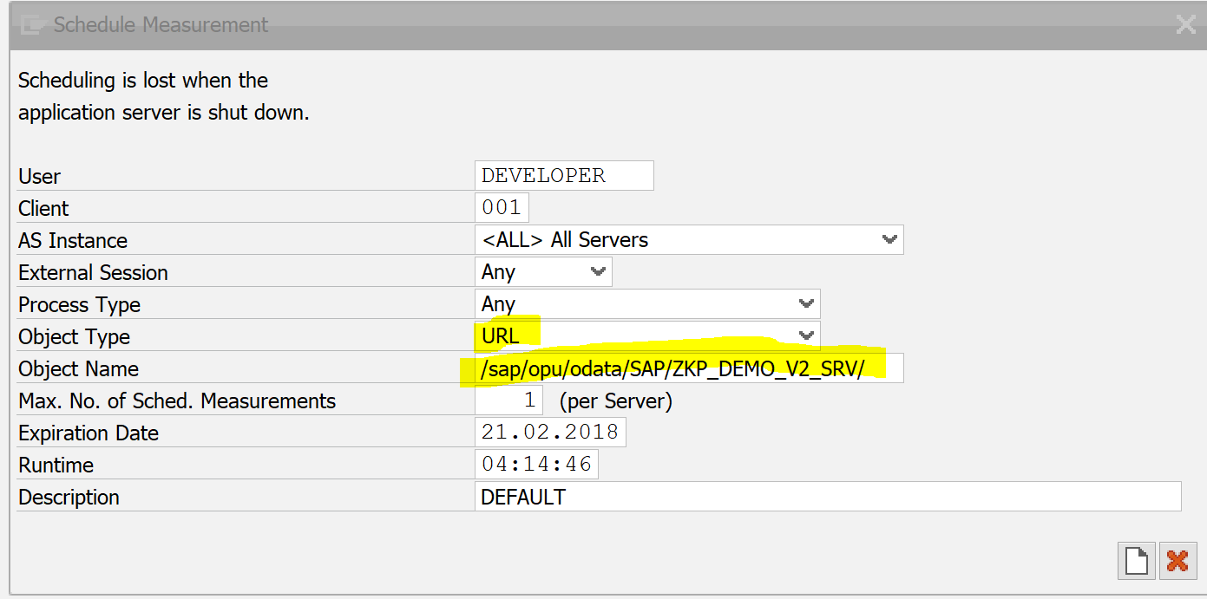
SAT Traces (SAT)
Create a new schedule
Use the URL for your gateway service

Slide 12
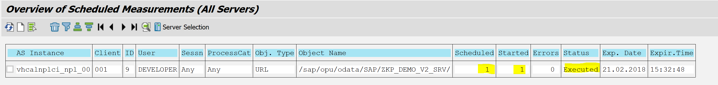
SAT Traces (SAT)
Execute your test
Status will change to “Executed”
Now you can view the measurement

Slide 13
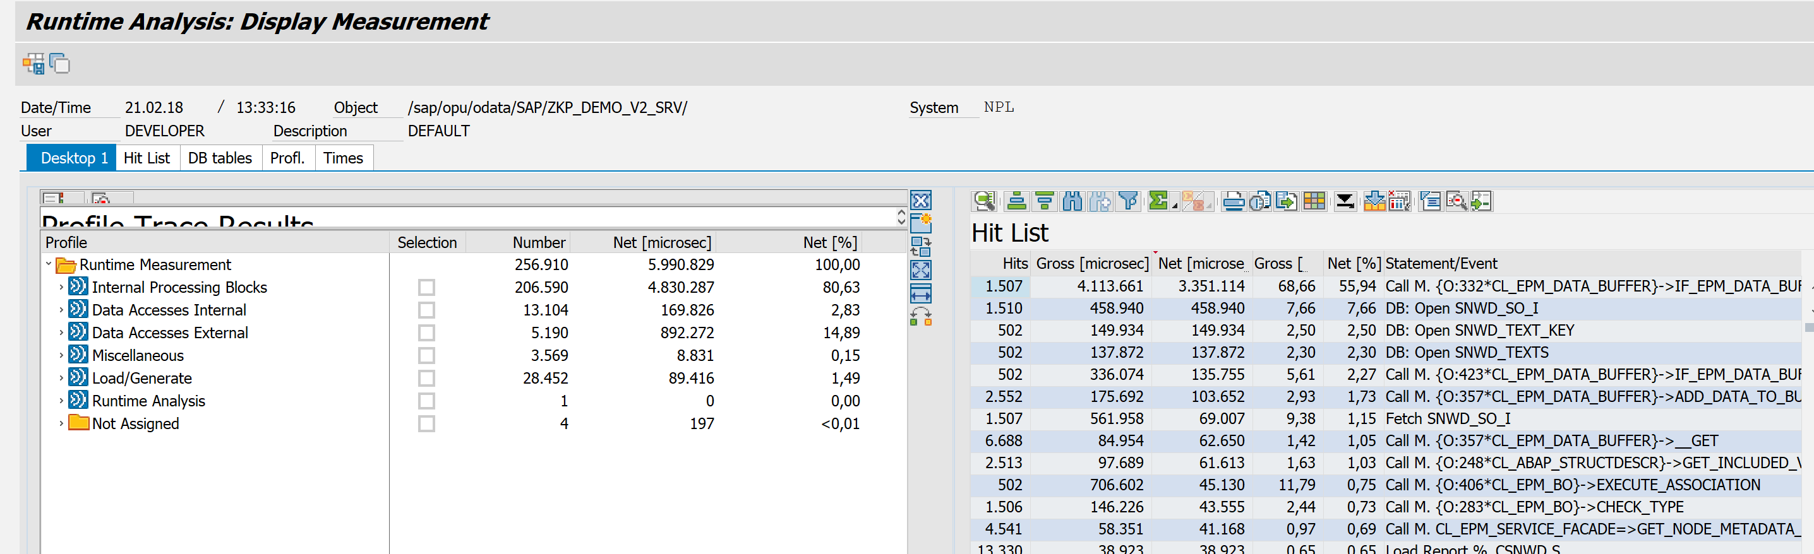
SAT Traces (SAT)
Now you can view the measurement

Slide 14

Browser Based Analysis

Slide 15
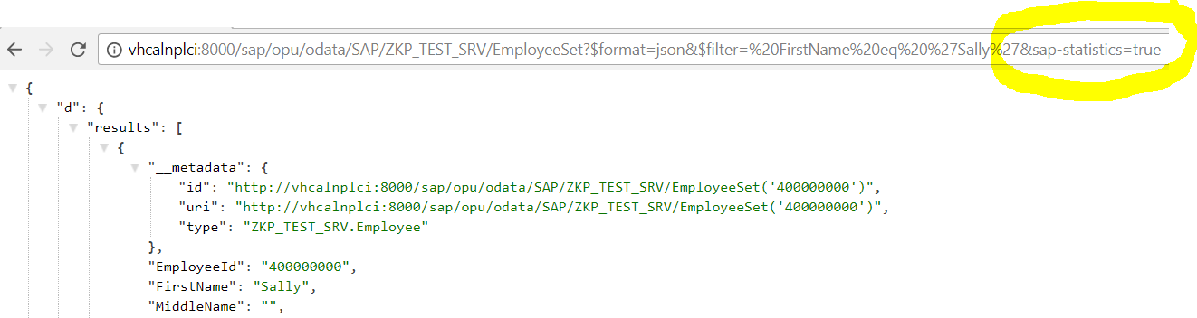
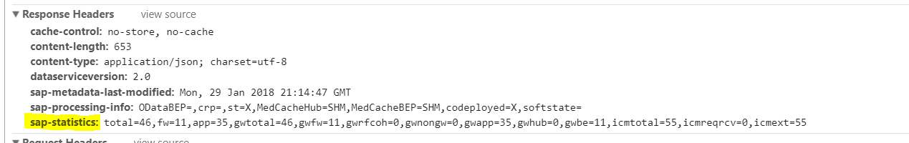
Browser Based Statistics
Activate via the form parameter $sap-statistics=true
Assist in identifying performance issues during service consumption

Slide 16
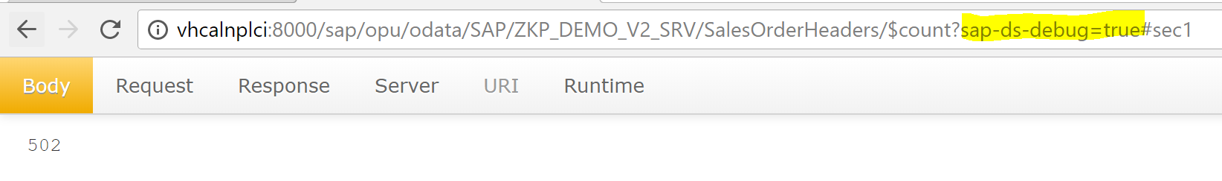
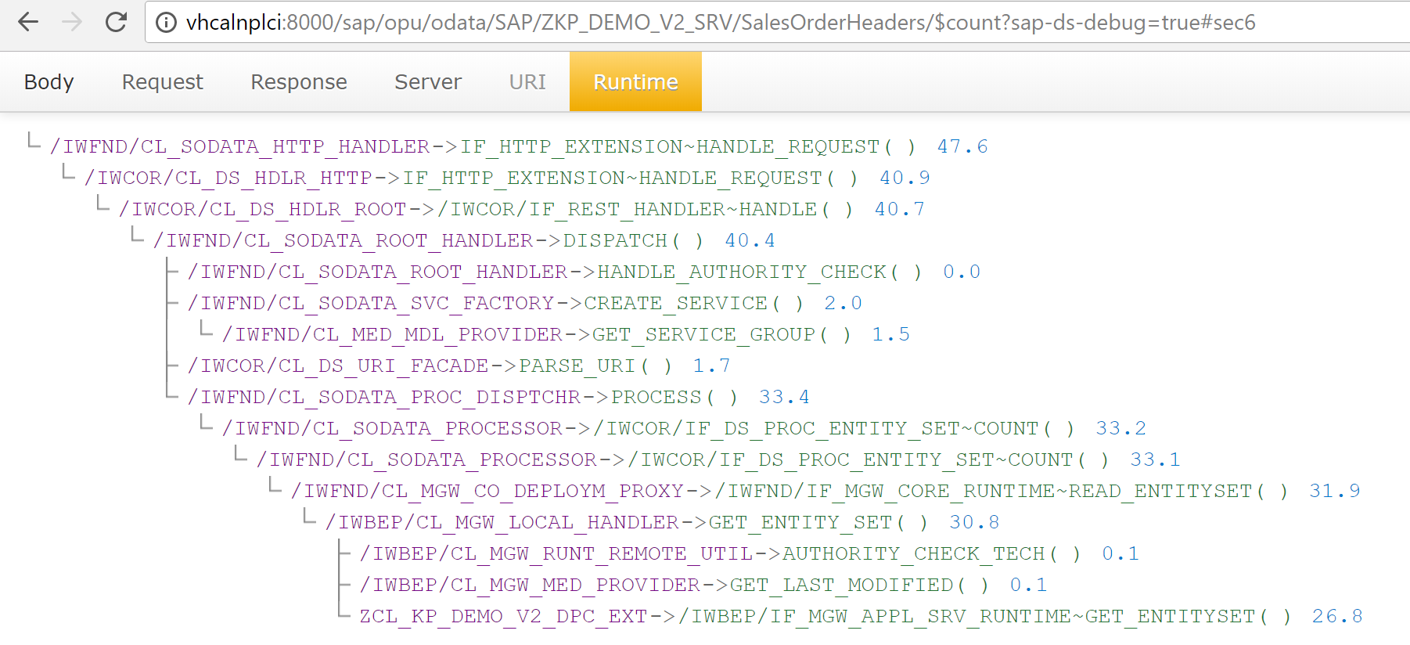
Browser Based Analysis
Activate via the form parameter sap-ds-debug=true
Most info you can pull from the request details via developer tools but the runtime trace is a handy for a break down of processing times

Slide 17

Application Development Considerations

Slide 18
Design Approach
Keep it lean
Discuss expectations with your team (UI Developers, etc)
Understand your data
Expected volume
Peak traffic times

Slide 19
Free or not to Free
SAP Gateway framework provides some capabilities for free, but at what cost
Note these cases are specific to development scenarios that require updating the data provider class

Slide 20
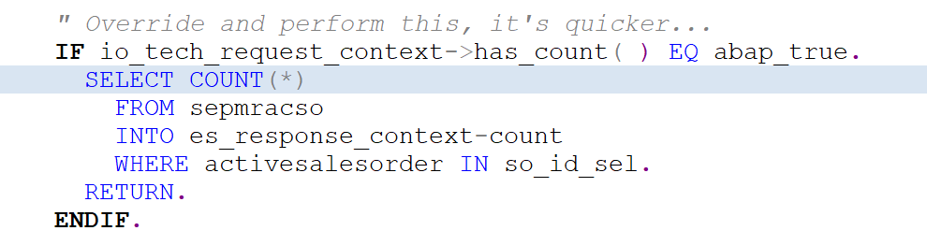
Free or not to Free: $count
Programmatically handle $count
There is hardly any code

Slide 21
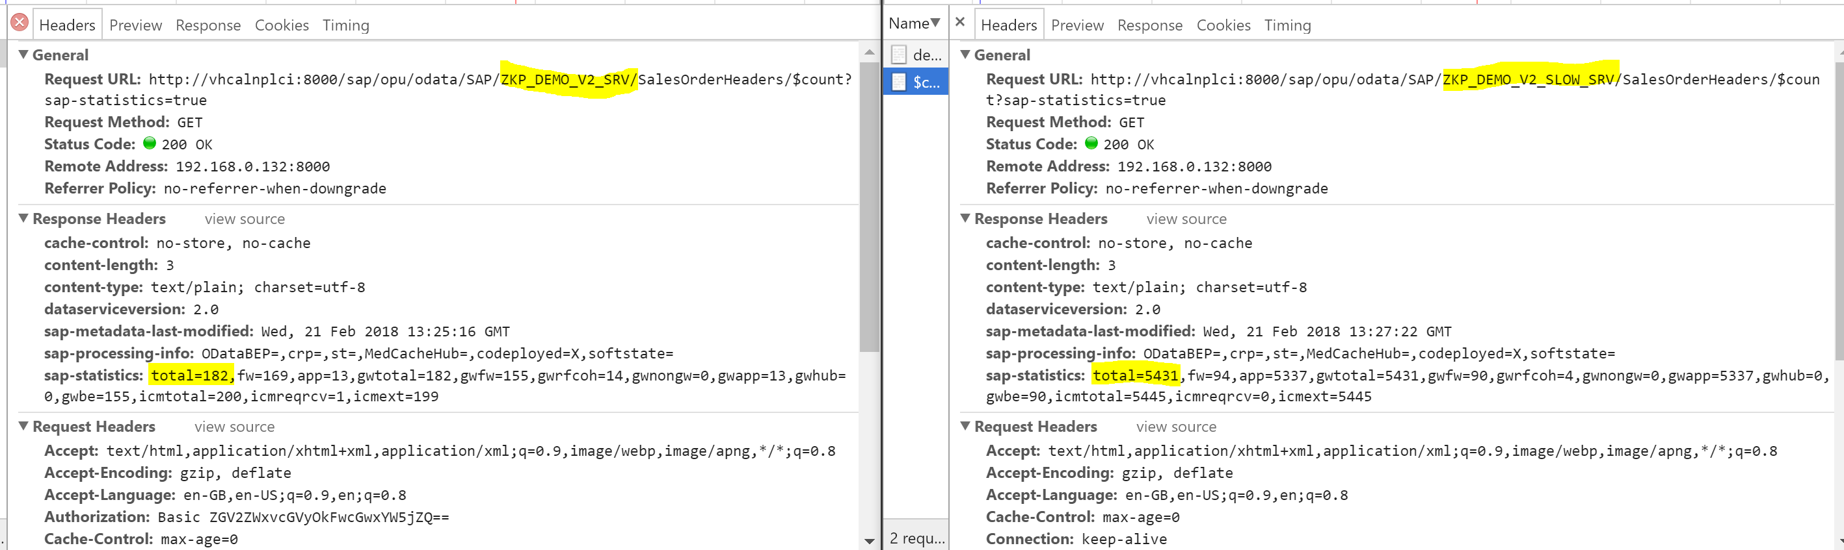
Free or not to Free: $count
$count will be called frequently for any UI5 apps using list type controls (tables, etc)

Slide 22
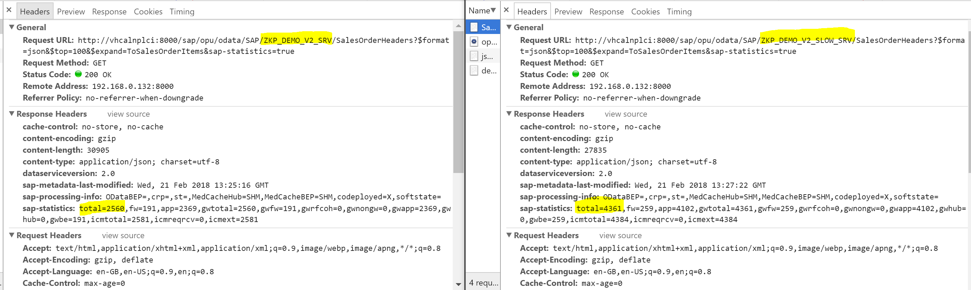
Free or not to Free: $expand
Programmatically handle $expand by redefining /IWBEP/IF_MGW_APPL_SRV_RUNTIME~GET_EXPANDED_ENTITYSET

Slide 23
Free or not to Free: Deep Insert
Programmatically handle inserts as deep inserts by redefining method /IWBEP/IF_MGW_APPL_SRV_RUNTIME~CREATE_DEEP_ENTITY
Only a single commit is required for all entities being updated
Kind of like the reverse of a $expand but for creating new records

Slide 24
Free or not to Free: Change Set Handling
Programmatically batch processing of changesets by redefining /IWBEP/IF_MGW_APPL_SRV_RUNTIME~CHANGESET_BEGIN, /IWBEP/IF_MGW_APPL_SRV_RUNTIME~CHANGESET_PROCESS & /IWBEP/IF_MGW_APPL_SRV_RUNTIME~CHANGESET_END

Slide 25
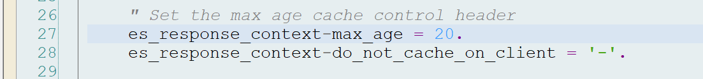
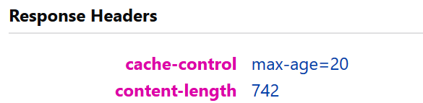
Cache Control Header
Consider using this for data that only changes infrequently. Typically master data entities (e.g. product details). A request is like to be made again for the same product detail for a shopping cart app.
Make sure you set a reasonable time for caching
Test in Firefox (wasted 20 minutes discovering this)

Slide 26

Testing

Slide 27
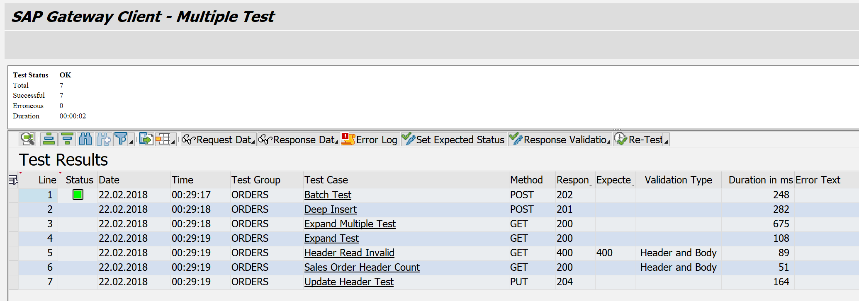
SAP Gateway Client Test Suite
Most people use the SAP Gateway Client to run tests and verify nothing technically broke following changes
Test Suite lets you build up tests and validate response headers

Slide 28
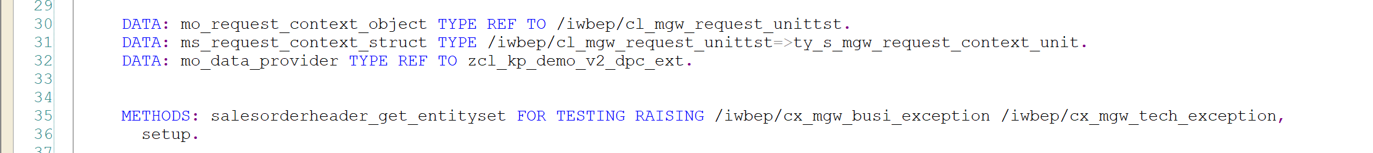
Automated Tests: Unit Test
Detailed Unit Testing possible via ABAP Unit Test APIs
Create a test class and add the following to the definition

Slide 29
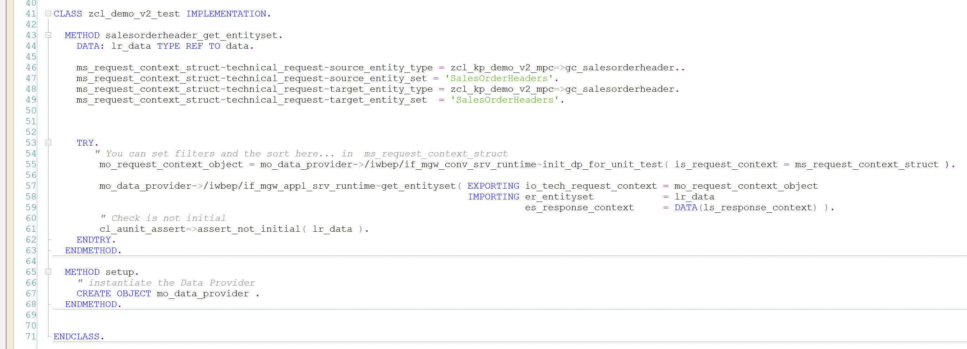
Automated Tests: Unit Test
Implement your setup method
Implement your test method as follows

Slide 30
Automated Tests: Unit Test
Implement your setup method
Implement your test method as follows

Slide 31
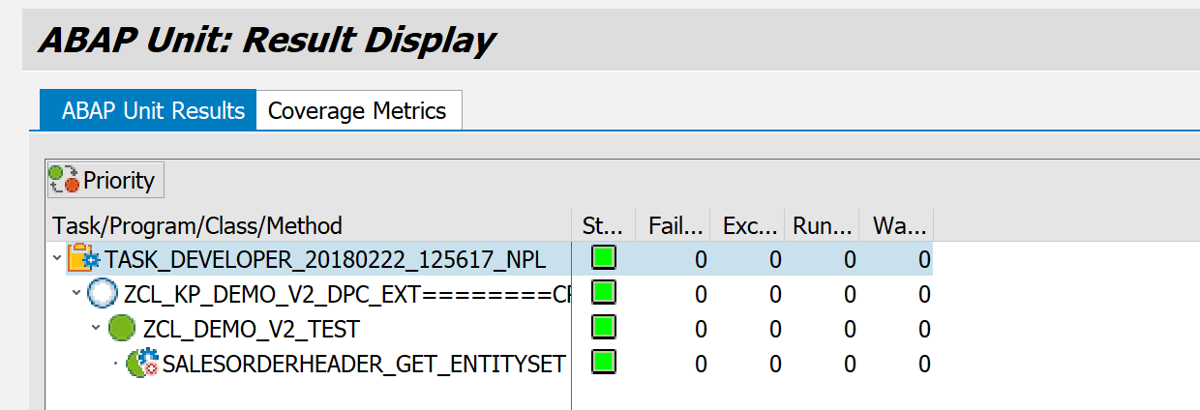
Automated Tests: Unit Test
Run your tests

Slide 32
Summary
Design, Develop, Test and Monitor using the tools available to assist you

Slide 33
Other Stuff To Think About
Move towards modelling via CDS and BOPF integration to future proofing your developments
Avoid V4 until end to end development complete (planned later this year) unless required
If required do not use the Gateway Builder tool to develop
Watch out for obsolete statements (check descriptions in class /IWBEP/IF_MGW_APPL_SRV_RUNTIME)

Slide 34
Shout Out
Andre Fischer
Nabi Zamani

Slide 35

Thank You

Slide 36
References
HTTP Caching
ODATA Service Deployment Options
SAP Gateway Roadmap
Avoiding Deprecated APIs

